Slide 1

Paris - Venues cluster for Tourist agency
Younes Younsi

Slide 2
Probleme description
As a tourism agency we need to know which venues are the same to
optimise the customer journey

Slide 3
Target Audience
My Client is a tourism agency, so I will focus on Paris borough during my analysis. The objective is to determin the 4 types of neighborhood of paris city .
how many Boroughs and neighberhoods are in paris.
how much venues are in each cluster.
what are the particularities of each cluster.
What are the best 5 cluster to visit

Slide 4
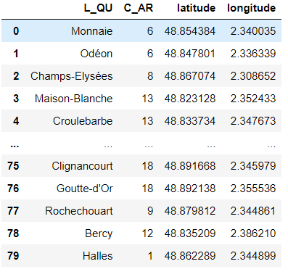
Neighberhood Data
the data for paris borough, Neighborhood, coordonates from the official web site of the Paris town :
https://opendata.paris.fr/explore/dataset/quartier_paris/information/

Slide 5
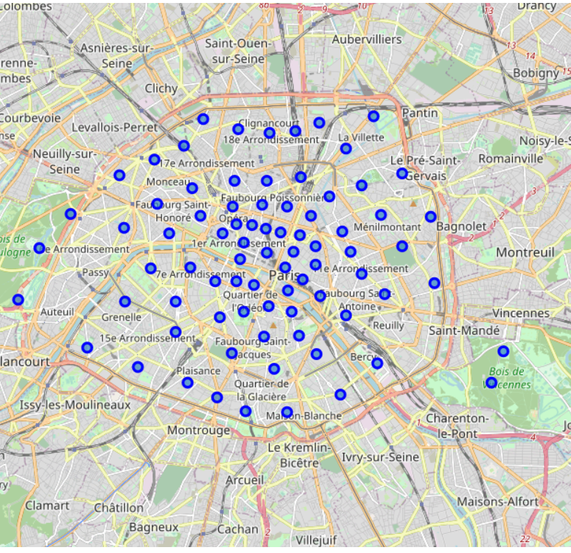
Neighberhood map
create map of Paris using latitude and longitude values

Slide 6
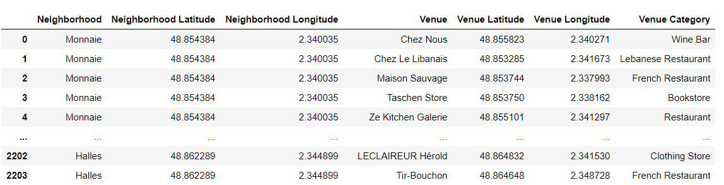
Venues Data
Getting 30 first venues of each neighberhood on dataframe
Source : (Foursquare)

Slide 7

Data analyses

Slide 8
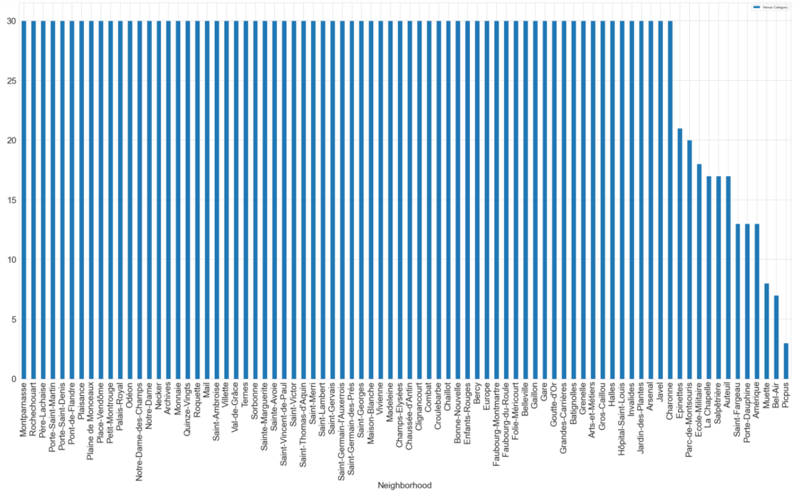
Groupe data by Neighborhood
There are 30 venues for each Neighborhood exept 12 of them , this because they are small ones.
alues
create map of Paris using latitude and longitude values

Slide 9
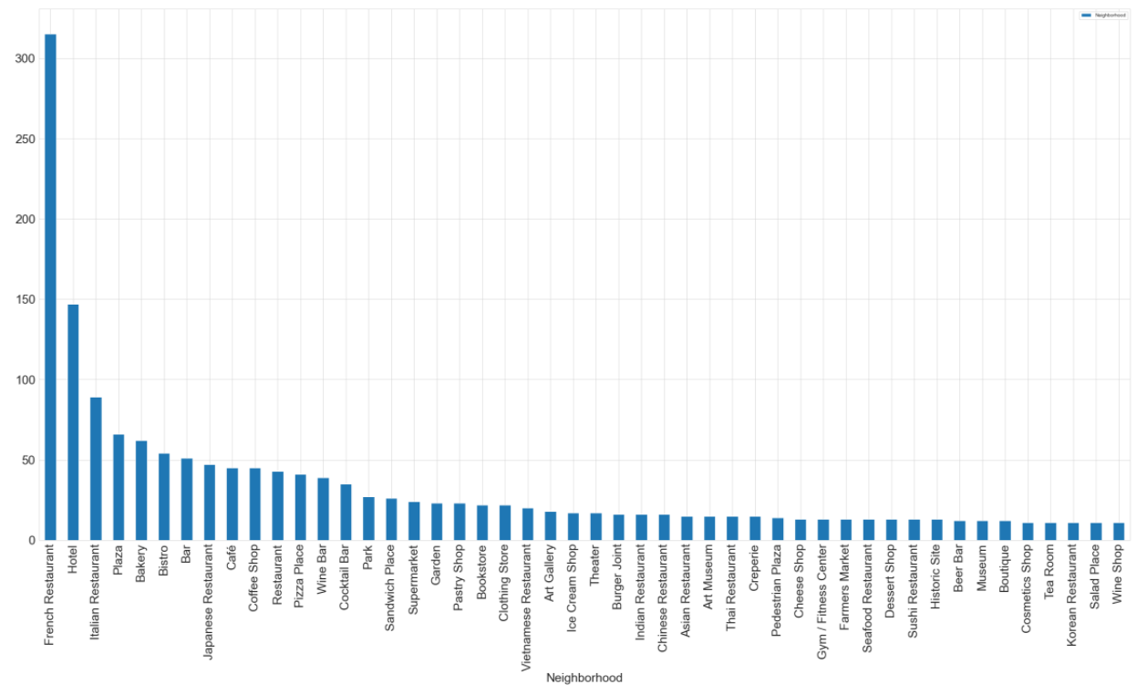
Group data by Venues cathegory
Top 10 Category show that the most Paris have à lot of restaurant, Hotel, Bar.
alues
create map of Paris using latitude and longitude values

Slide 10
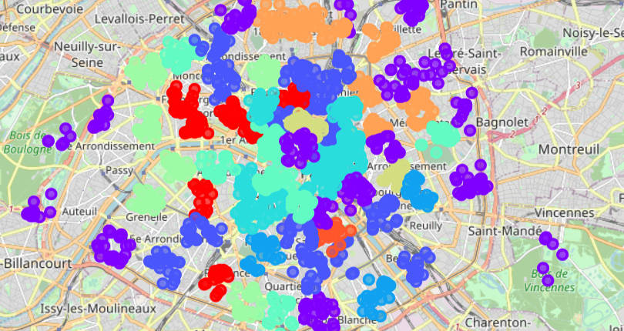
Ten Paris clusters

Slide 11
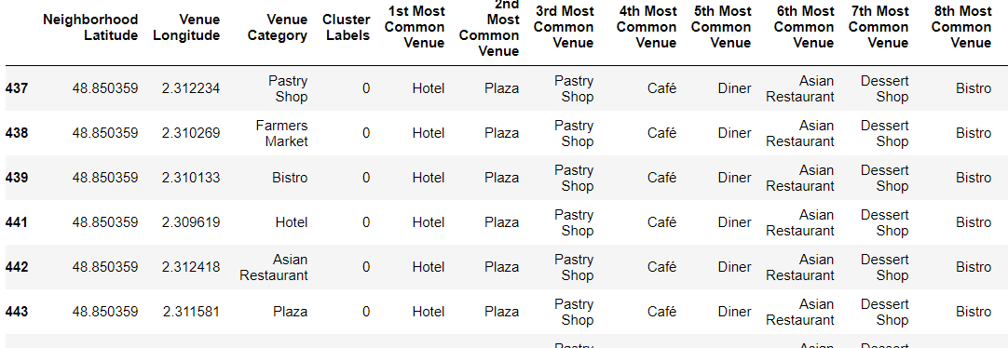
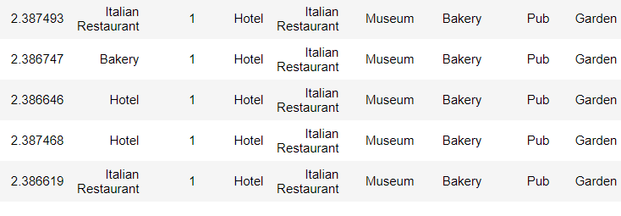
Clusters
Cluster 1
Cluster 2
- contains 206 hotels and 54 shops
- contains 78 Supermarket and 29 hotels and 29 bars

Slide 12
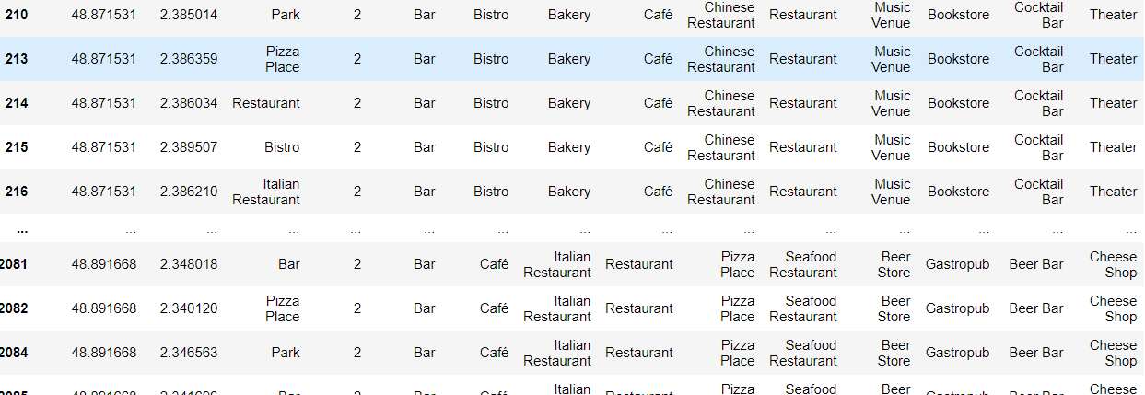
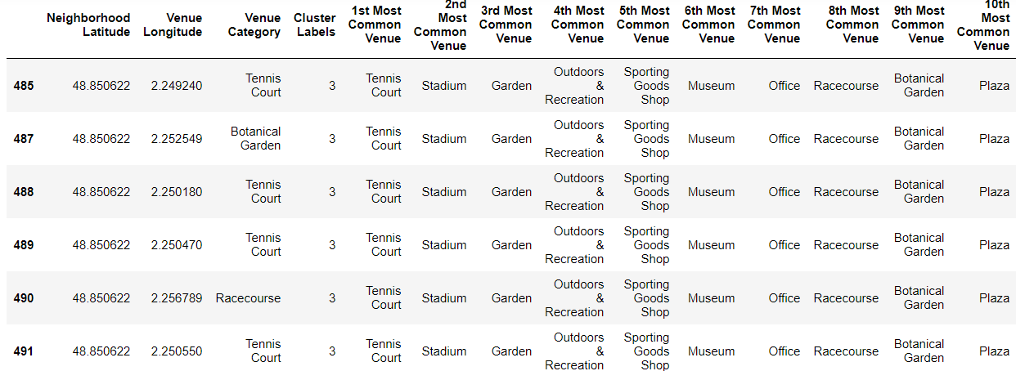
Clusters
Cluster 3
Cluster 4
contains 293 bars and 76 Pizza Place
contains 83 hotels and 84 coffee shop and 87 wine bars 61 parks

Slide 13
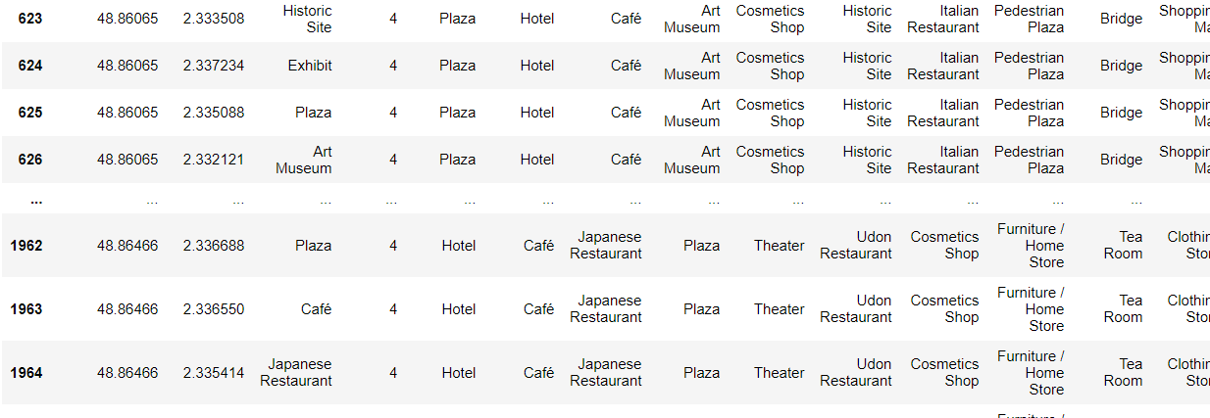
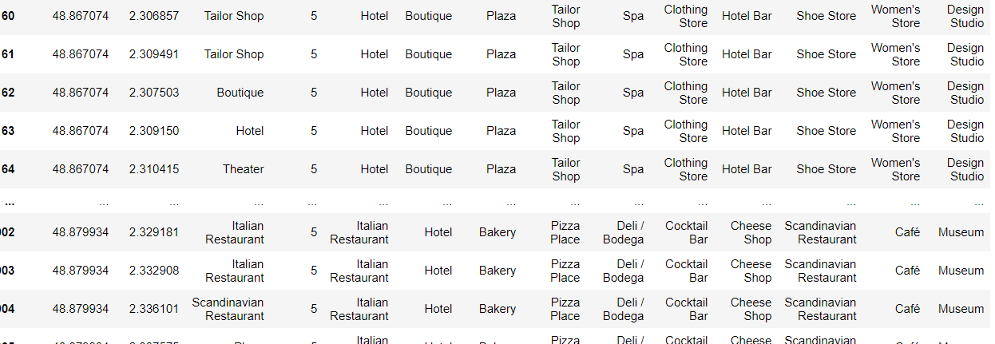
Clusters
Cluster 5
Cluster 6
contains 158 coffee shop and 58 wine bars
contains 232 plaza 76 hotels, 57 cafés

Slide 14
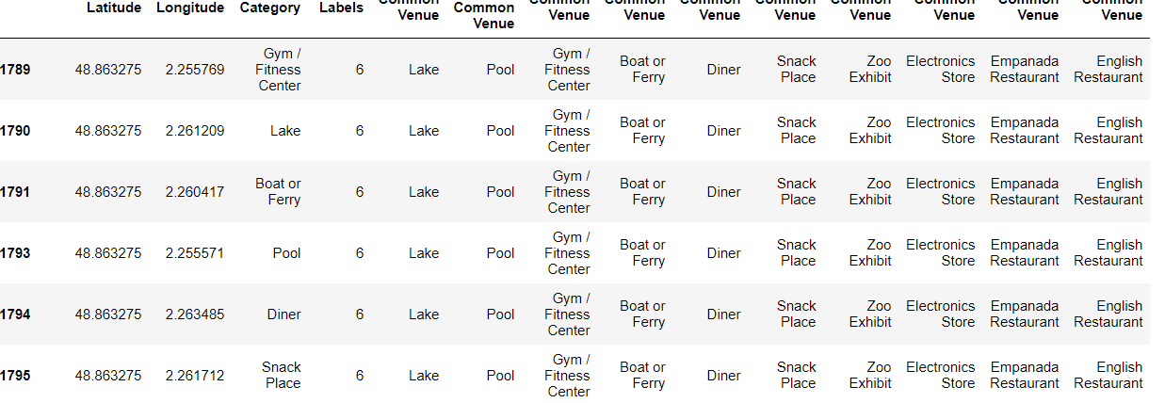
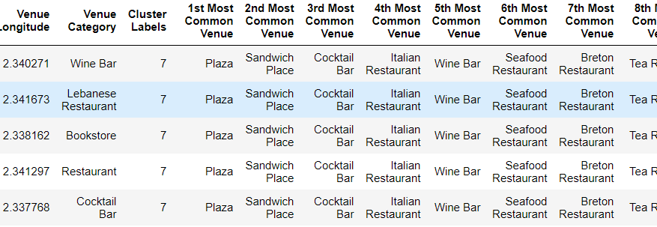
Clusters
Cluster 7
Cluster 8
contains 94 italian restaurant 94 hotels and 49 plaza
contains 94 cocktail bar 29 hotel and 29 thai restaurant.

Slide 15
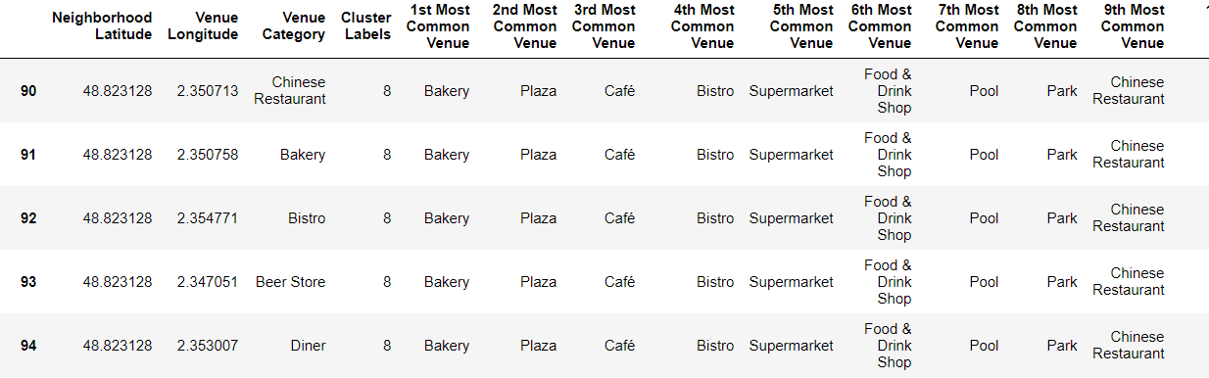
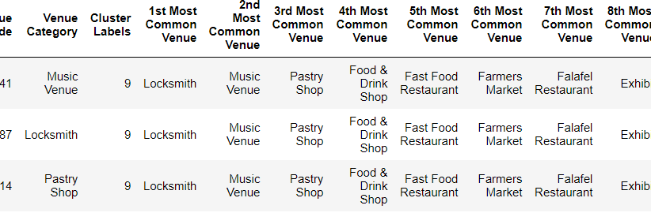
Clusters
Cluster 9
Cluster 10
contains 204 bars and 76 pizza place
contains 59 garden and 56 meseum

Slide 16
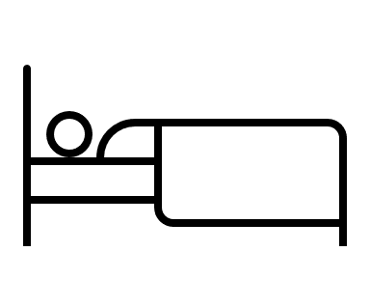



Conclusion
Plaza
Cluster 6
Bar
Clusters 3,5,8,9
Hotel
Cluster 1,4,6,7
Museum and garden
Clusters 10

